Slide 1
FORECASTING NETFLIX STOCK PRICES WITH LSTM:
MACHINE LEARNING INSIGHTS.
Guide:Mr. Mahender Saragada
Team:
B. LUCKY HEMANTH RAJ (21P61A3207)
CH.SRI NAGA SANTOSH (21P61A3212)
J.SAI AKANKSHA (21P61A3224)
K. INDRANI (21P61A3226)

Slide 2
CONTENT
ABSTRACT
INTRODUCTION
LITERATURE SURVEY
EXISTING SYSTEM
PROPOSED SYSTEM
METHODOLOGY
SYSTEM REQUIREMENTS
DESIGN
IMPLEMENTATION
CONCLUSION
FUTURE SCOPE

Slide 3
ABSTRACT
This project employs machine learning to analyze and forecast Netflix (NFLX) stock prices using historical data from Yahoo Finance. The study covers 13 years of stock data, including attributes like opening, highest, lowest prices, adjusted close, and trading volume. A candlestick chart visualizes stock price movements, while correlation analysis explores relationships between various attributes and the closing price. The core involves an LSTM (Long Short-Term Memory) neural network to capture temporal dependencies. The model, with multiple LSTM layers and dense layers, is optimized using the Adam optimizer with a mean squared error loss function. The dataset is divided into training and testing sets to evaluate model performance. Training through iterative epochs enhances prediction accuracy. Post-training, the model predicts Netflix's closing price using new input features. This project showcases the application of advanced machine learning techniques in financial data analysis, highlighting their potential to improve decision-making in the stock market.

Slide 4
INTRODUCTION
Founding and Initial Service: Netflix was founded in August 1997 by Marc Randolph and Reed Hastings in Scotts Valley, California, initially operating as a movie rental service that mailed DVDs to customers.
Global Expansion: Over time, Netflix transitioned from a DVD rental service to a streaming platform and now serves over 151 million paid subscribers across more than 190 countries.
Content Diversity: Netflix offers a wide range of content, including TV series, documentaries, and feature films, spanning various genres and languages, with an increasing focus on original productions​(netflix).
Innovative Business Model: Netflix revolutionized the entertainment industry by shifting from a pay-per-rental model to a subscription-based service, allowing users to stream unlimited content for a fixed monthly fee. This move was instrumental in its growth and global dominance​(netflix).

Slide 5
LITERATURE SURVEY
S No | Title | Author | Journal Name & Year | Methodology Adapted | Key Findings | Gaps
1 | A Survey of Stock Price Prediction of Netflix Using Machine Learning | A.Gopala krishna, K.Tanuja, G. Pallavi, G. Tarun Kalyan | International Journal of Innovative Science and Research Technology & 5,May-2023 | Machine Learning, Support Vector Machine. | Recurrent Neural Netwoks(RNN) | Limited External Factors, Model Interpretability, Overfitting Risk.
2 | Netflix Stock Price Movements Insights from Data Mining | V. Gowri,B. Harish, Fahad Ahmed, M. Srinath | IEEE 2nd Mysore Sub Section International Conference, 2022. | Prediction algorithm, Data Models, Decision Trees. | Machine Learning as a Tool for Stock Price Prediction | Limited Scope of Data, Model Overfitting.

Slide 6
LITERATURE SURVEY
3 | Stock Prediction Using ARIMA | Rishabh Sharma, Rajeev Sharma, Shanmugasudaram Hariharan | International Conference on Computational Intelligence and Computing Applications(ICCICA) | Analytical models, Accuracy, Predictive models, Computational efficiency. | Efficacy of the ARIMA Model, Potential for Hybrid Models, Reliability in Stock Forecasting. | Model Limitations in Complex Market Conditions, Comparative Model Evaluation.
4 | Analysis of a Stock Exchange and Future Prediction Using LSTM | B.Shivani, S. Govinda Rao | 4th International Conference on Recent Trends in Computer Science and Technology. | Machine Learning,Deep Learning,Lstm | Adaption of Machine Learning and Deep Learning for stock Prediction. | Lack of Consideration for External Factors, Lack of Interpretability, Model Scalability.

Slide 7
EXISTING SYSTEMS
Predicting stock prices is influenced by various factors, including market trends, economic indicators, company performance, and global events.
Machine learning algorithms like regression models, neural networks, and support vector machines can analyze historical data to identify patterns and make predictions.
For forecasting Netflix's stock price, relevant data like historical prices, market trends, economic indicators, and news articles should be collected.
Machine learning models may not capture all influencing factors, leading to inherent uncertainty in predictions.
Caution is necessary when using these predictions for investment decisions, and consulting a financial advisor is recommended.

Slide 8
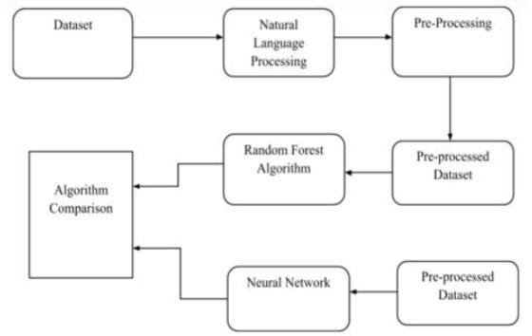
PROPOSED SYSTEM
Collect historical stock prices for Netflix (NFLX) from sources like Yahoo Finance or Google Finance, including trading volume and price metrics. Enhance the dataset with external factors such as market indices, macroeconomic indicators, and sentiment analysis.
Split the data into training, validation, and test sets, with recent data reserved for testing. Convert the time series into sequences with past observations to predict future values for LSTM input.
Deploy the trained model in a production environment to forecast with new data. Continuously monitor performance, retrain with updated data, and periodically update the model to adapt to market changes.

Slide 9
METHODOLOGY
The methodology for the project "Forecasting Netflix Stock Prices with LSTM" involves several key steps:
Data Collection
Data Preprocessing
Data Visualization and Analysis
Model Selection and Architecture
Model Training
Model Evaluation
Prediction and Deployment

Slide 10
SYSTEM REQUIREMENTS
Software Requirements
• Programming Language : Python
• Libraries and Frameworks :
-Data manipulation and Analysis - Pandas, Numpy
-Machine Learning - Scikit-Learn, Tensorflow for Keras
-Data Visualization - Matplotlib, Seaborn
-IDE/Text Editor - Jupyter Notebook, VS code, Pycharm
• Operating System - Windows, macOS, or Linux
Hardware Requirements
• Processor (CPU) : Dual-core processor (Intel i5 or equivalent)
• Memory (RAM) : 8 GB
• Storage : 100 GB of free disk space

Slide 11
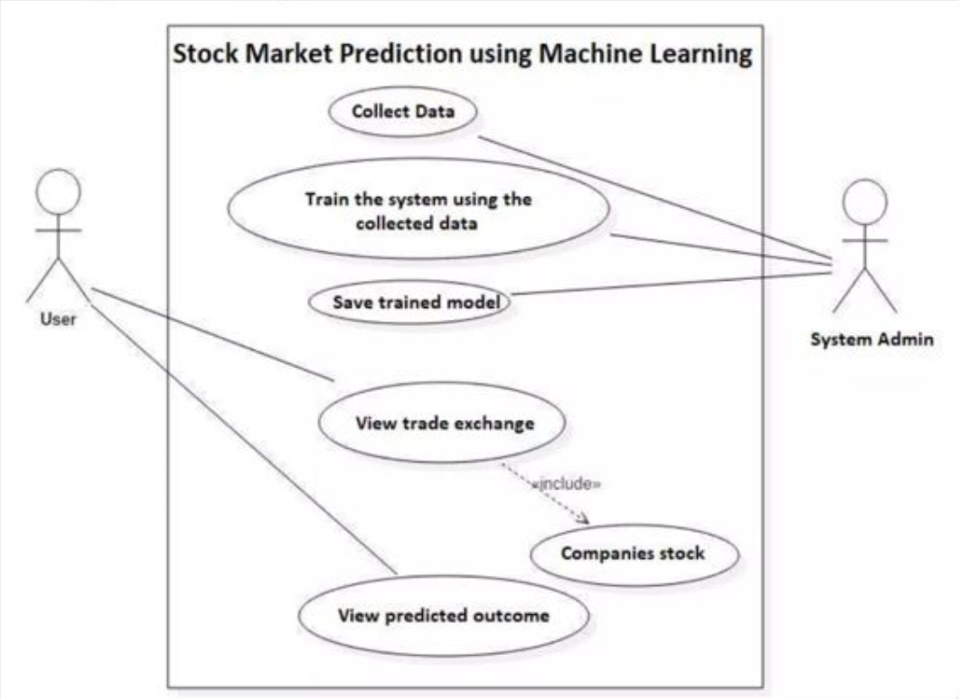
DESIGN (Use Case):

Slide 12
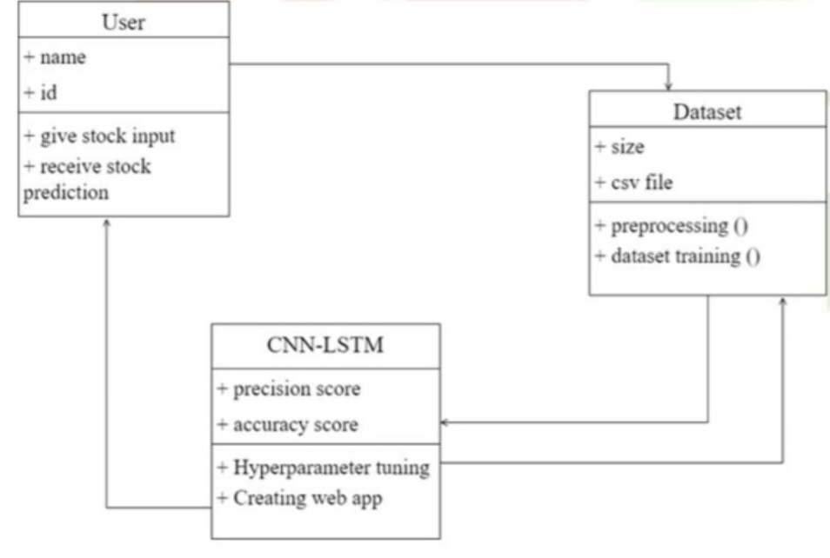
DESIGN (Class Diagram):

Slide 13
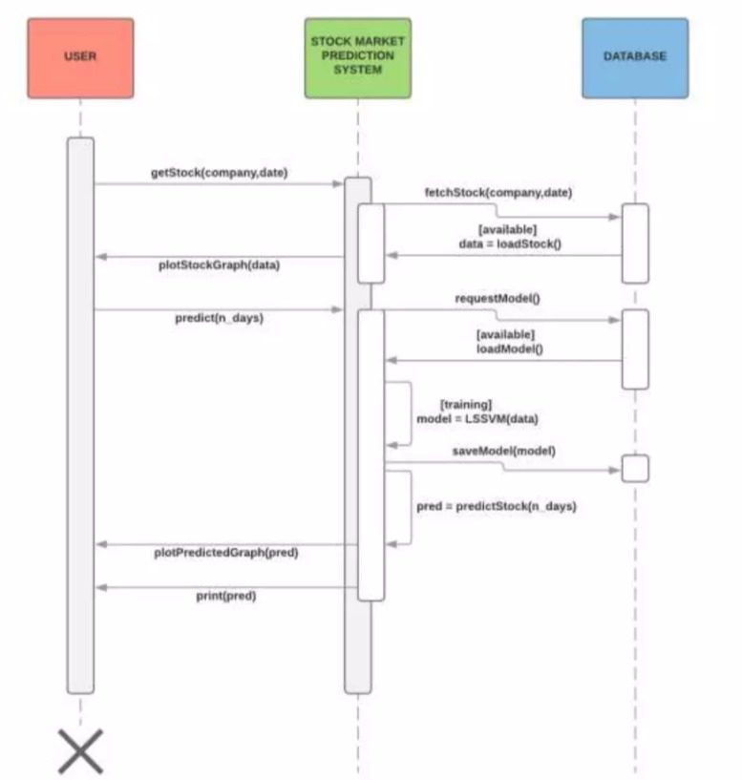
DESIGN (Sequence Diagram):

Slide 14
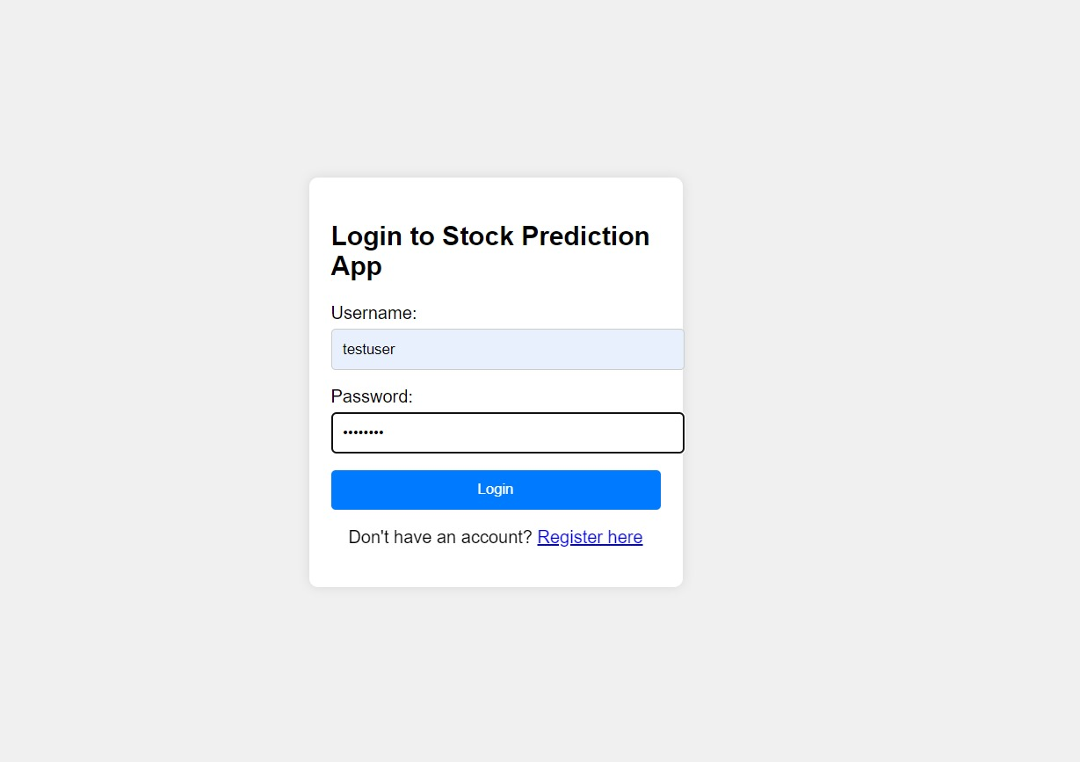
IMPLEMENTATION:

Slide 15
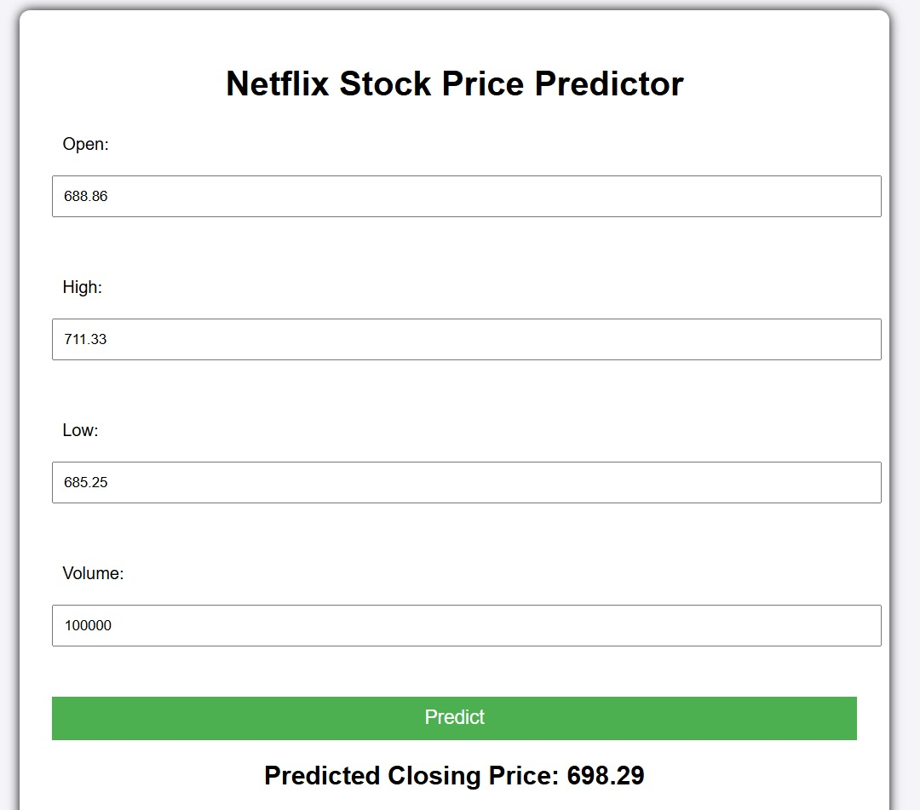

Slide 16
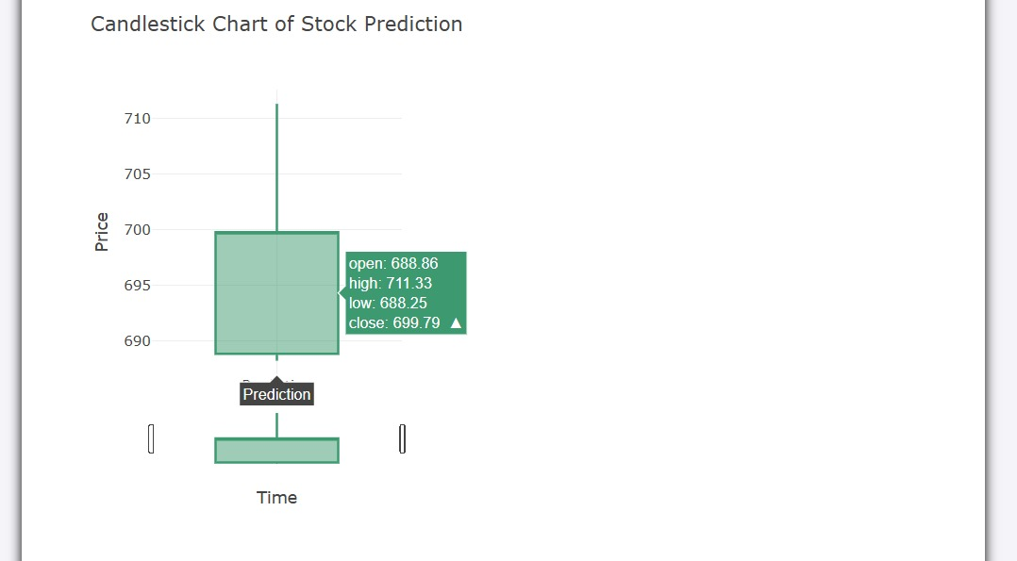

Slide 17
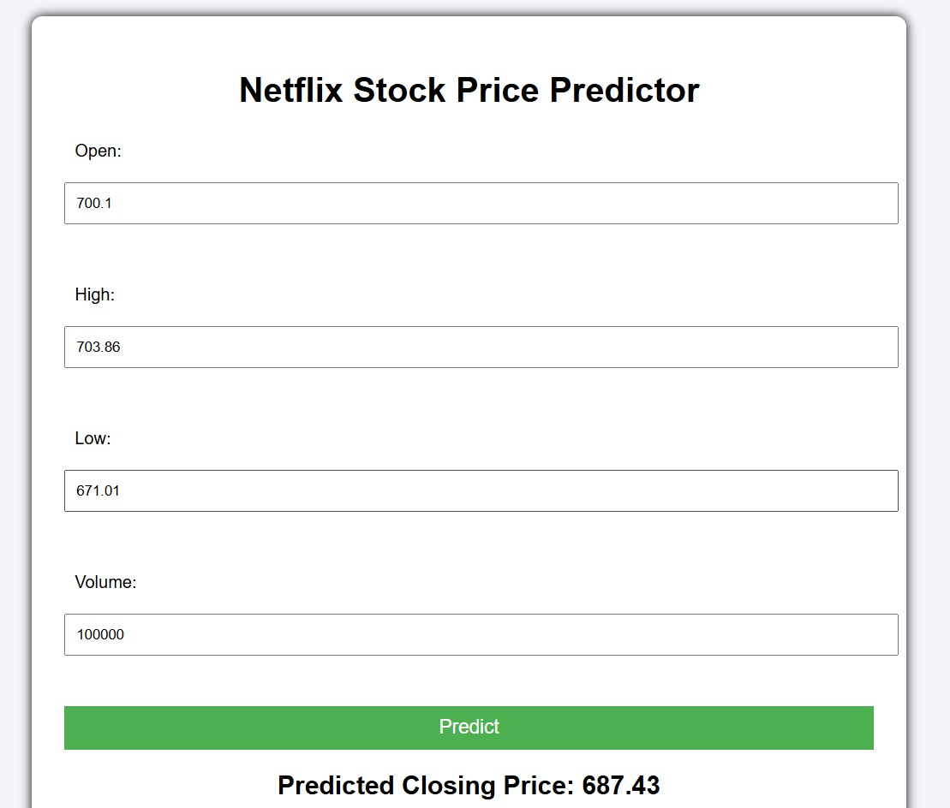

Slide 18
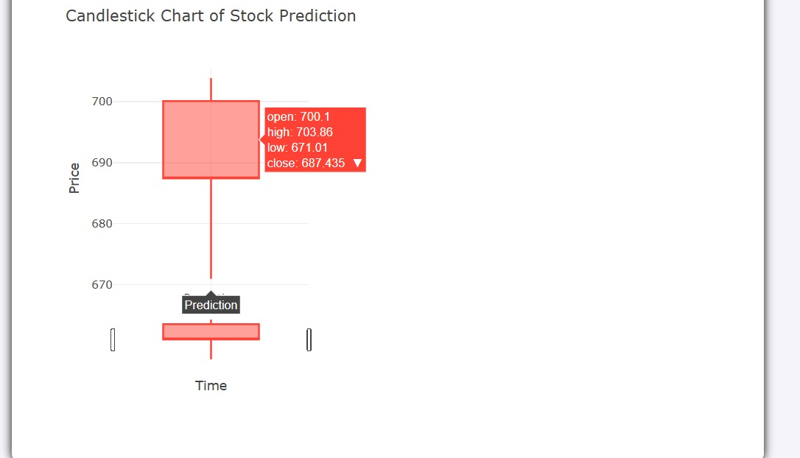

Slide 19
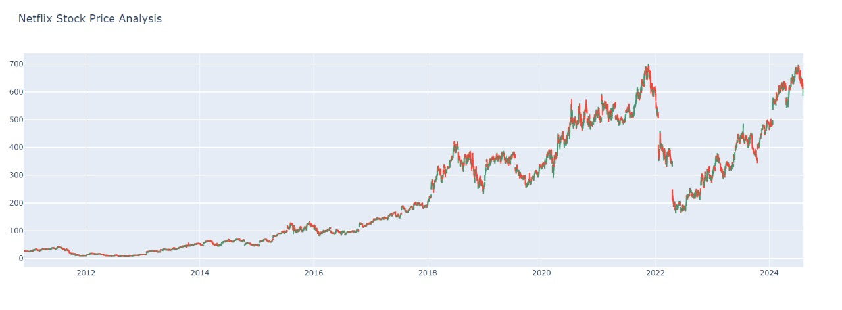

Slide 20
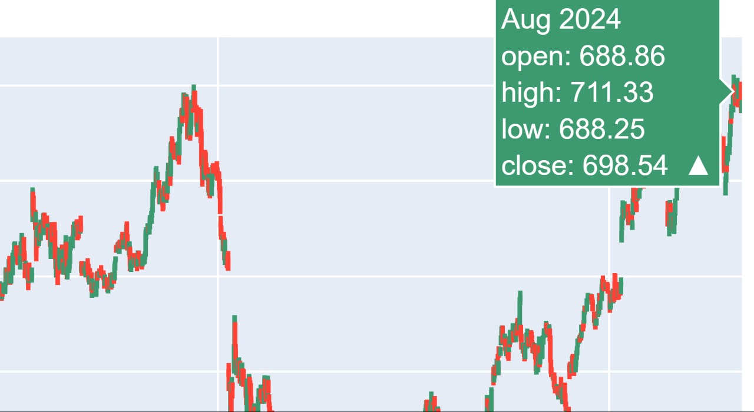

Slide 21
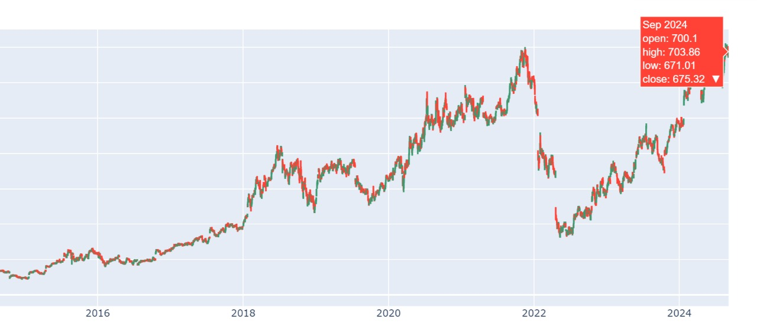

Slide 22
CONCLUSION
This project used Long Short-Term Memory (LSTM) neural networks to forecast Netflix (NFLX) stock prices based on 13 years of historical data. The LSTM model effectively captured complex temporal patterns, resulting in accurate predictions. Key steps included data collection from Yahoo Finance, thorough preprocessing, and structuring the data into sequences. Exploratory Data Analysis (EDA) using tools like candlestick charts and correlation analysis helped identify key factors influencing stock prices. Despite challenges with data quality, model interpretability, and real-time integration, the project highlighted LSTM potential in stock market forecasting. Future work could include incorporating sentiment analysis and exploring alternative deep learning models.

Slide 23
FUTURE SCOPE
1. Feature Engineering:
Add Technical Indicators: Incorporate Moving Averages (MA), Relative Strength Index (RSI), MACD, and Bollinger Bands to enhance stock trend prediction.
2. Model Improvement:
Hyperparameter Tuning: Optimize LSTM model parameters like the number of layers, units, learning rate, and batch size using grid search or random search.
3. Prediction and Evaluation:
Rolling Window Forecasting: Use a rolling window approach to predict stock prices, allowing for more recent data-based predictions.
4. Enhanced Data Visualization:
Advanced Plots: Add moving averages and trendlines to compare actual stock prices with predictions for better visualization.

Slide 24


